Slide 1
UNIT-III
Data Classification

Slide 2
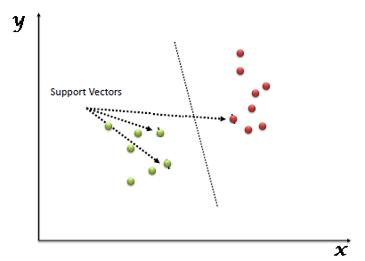
SVM
Support Vector Machine
supervised machine learning algorithms
It can be used for classification, as well as for regression.
In this model, plot each data item as a unique point in an n-dimension (where n is actually, the number of features), with the value of each of the features being the value of that particular coordinate.
Then, perform the process of classification by finding the hyper-plane that differentiates the two classes.

Slide 3
Advantage
The data is not regularly distributed.
SVM is generally known to not suffer the condition of over-fitting.
Performance of SVM, and its generalization is better on the dataset.
SVM is known to have the best results for classification types of problems.

Slide 4
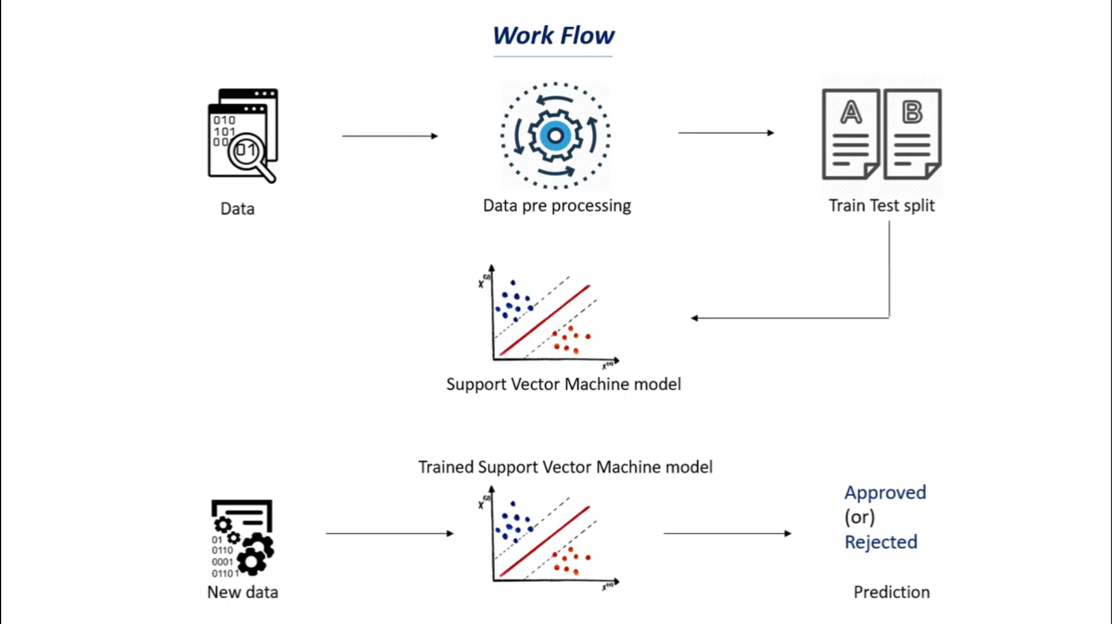
General Diagram

Slide 5
Example
Any bank, approves a loan based on the two most vital points:
1) How risky is the borrower currently, (This is the factor, on which the interest rate of the borrower will depend), and
2) Should they lend the money to the borrower at the given risks?
If both of these conditions give an affirmatory result, the bank proceeds with the loan approval.

Slide 6
K Nearest Neighbor Algorithm
K-Nearest Neighbors, or KNN
Simple machine learning algorithms
It is a non-parametric, lazy learning algorithm
Does not make any assumptions about the underlying data.
It implies that there is little to no training phase
It can immediately classify new data points

Slide 7
pros and cons of KNN
Pros:
No assumptions about data
Simple algorithm — easy to understand
Can be used for classification and regression
Cons:
High memory requirement — All of the training data must be present in memory in order to calculate the closest K neighbors
Sensitive to irrelevant features
Sensitive to the scale of the data since we’re computing the distance to the closest K points

Slide 8
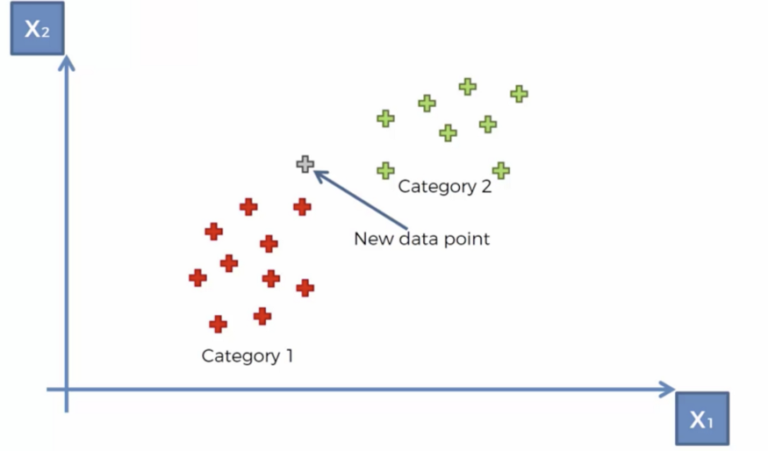
Algorithm
Pick a value for K (i.e. 5).

Slide 9
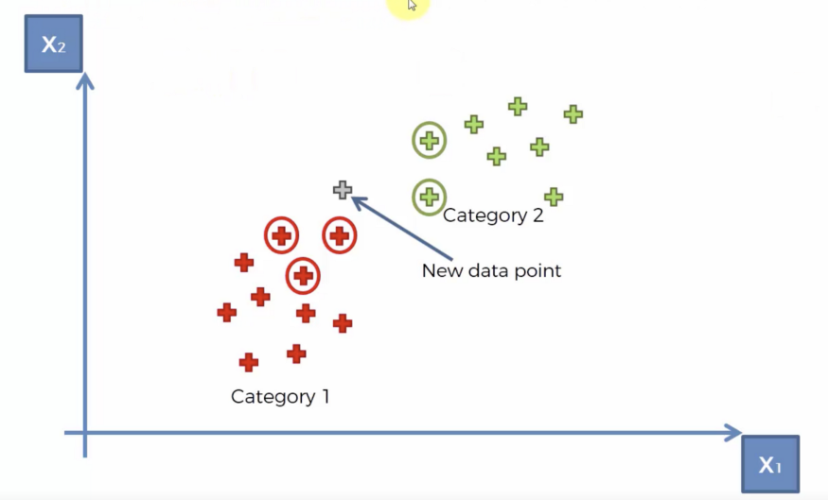
Contd.,
Take the K nearest neighbors of the new data point according to their Euclidean distance.

Slide 10
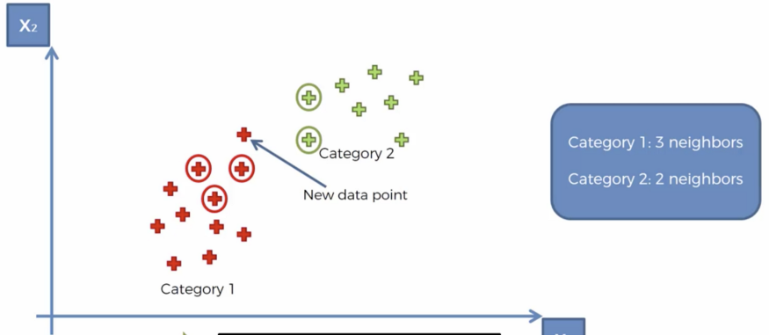
Contd.,
Among these neighbors, count the number of data points in each category and assign the new data point to the category where you counted the most neighbors.

Slide 11
Sentiment Analysis

Slide 12
Topics:
Sentiment Analysis Overview
Sentiment Analysis Application
Sentiment Analysis process

Slide 13
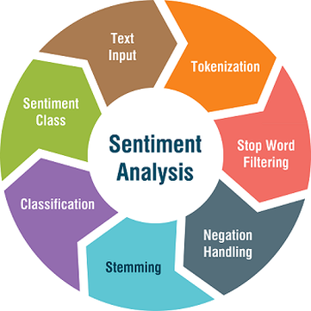
Overview
What is sentiment analysis?
Sentiment Analysis is the process of ‘computationally’ determining whether a piece of writing is positive, negative or neutral. It’s also known as opinion mining, deriving the opinion or attitude of a speaker.
Why sentiment analysis?
Business: In marketing field companies use it to develop their strategies, to understand customers’ feelings towards products or brand, how people respond to their campaigns or product launches and why consumers don’t buy some products.
Politics: In political field, it is used to keep track of political view, to detect consistency and inconsistency between statements and actions at the government level. It can be used to predict election results as well!
Public Actions: Sentiment analysis also is used to monitor and analyse social phenomena, for the spotting of potentially dangerous situations and determining the general mood of the blogosphere.

Slide 14

Meet sentiment analysis (1) (buzzilions.com)
Notes:
? Should I show Bing Liu‘s slide on aggregation?

Slide 15

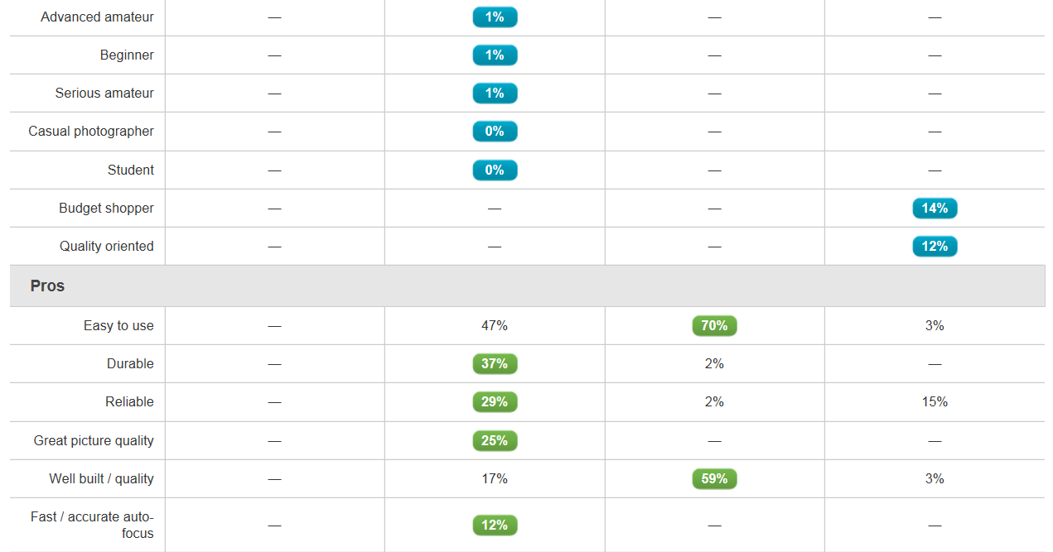
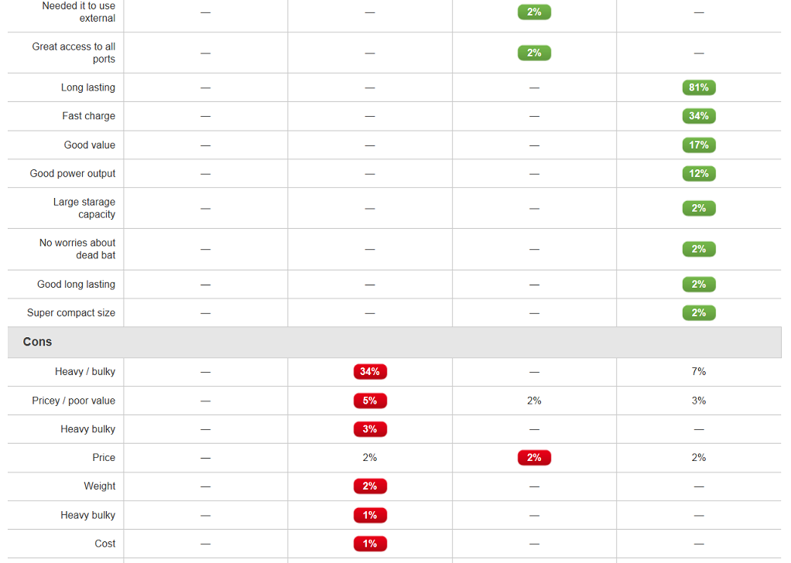
Aggregations (buzzilions.com)
Notes:
Das erste kann man benutzen für social search Einstieg! (ask your friends)

Slide 16

Meet sentiment analysis (2)
Notes:
http://sendible.com/features/review-monitoring

Slide 17
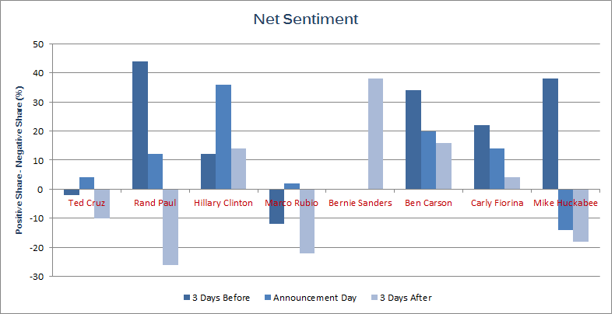
Meet sentiment analysis (3)
Notes:
http://www.epolitics.com/2015/05/28/internet-loves-hillary-clinton-hates-huckabee-gave-cruz-a-first-mover-boost/

Slide 18
A field of study with many names
Opinion mining
Sentiment analysis
Sentiment mining
Subjectivity detection
...
Often used synonymously
Some shadings in meaning
“sentiment analysis“ describes the current mainstream task best 🡺 I‘ll use this term.

Slide 19

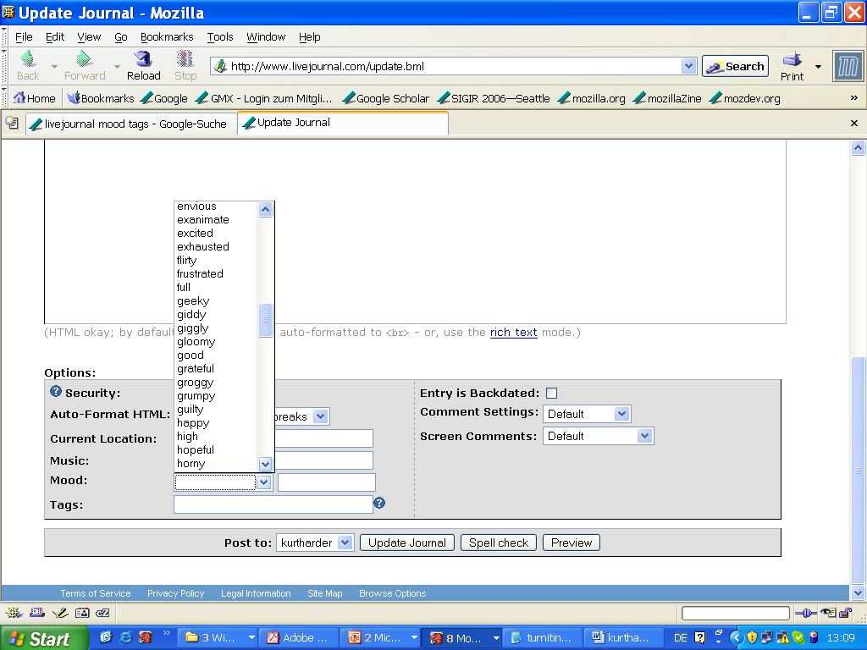
Happiness in blogosphere. Or: document-oriented sentiment analysis
Notes:
http://members.iinet.net.au/~sauterp@iinet.net.au/funny/smiley.gif

Slide 20
Aspect-oriented sentiment analysis: It‘s not ALL good or bad
Example:
Yesterday, I bought a Nokia phone
The voice on my phone was not clear.
The camera was good.
Small phone – small battery life.

Slide 21
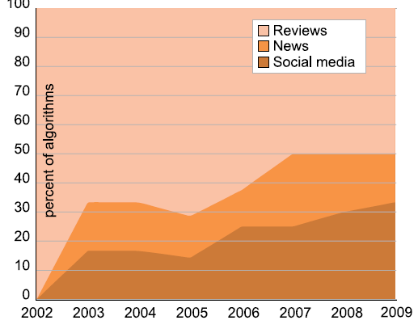
Data sources
Review sites
Blogs
News
Microblogs
From Tsytsarau & Palpanas (2012)

Slide 22
The unit of analysis
community
another person
user / author
document
sentence or clause
aspect (e.g. product feature)
Notes:
TODO: hiervon werden einige besprochen, andere nicht -> markieren oder später drauf zurückkommen

Slide 23
The analysis method
Machine learning
Supervised
Unsupervised
Lexicon-based
Dictionary
Flat
With semantics
Corpus
Discourse analysis

Slide 24
Features
Features:
words (bag-of-words)
n-grams
parts-of-speech (e.g. Adjectives and adjective-adverb combinations)
opinion words (lexicon-based: dictionary or corpus)
valence intensifiers and shifters (for negation); modal verbs; ...
syntactic dependency
Feature selection based on
frequency
information gain
odds ratio (for binary-class models)
mutual information
Feature weighting
term presence or term frequency
inverse document frequency (🡪 TF.IDF)
term position : e.g. title, first and last sentence(s)

Slide 25
Issues in aspect-/sentence-oriented SA Objects, aspects, opinions
Yesterday, I bought a Nokia phone
The voice on my phone was not clear.
The camera was good.
I wanted a phone with good voice quality.
So I was satisfied and returned the phone to BestBuy yesterday.
Small phone – small battery life.
Object identification
Aspect extraction
Grouping synonyms
Opinion orientation classification

Slide 26
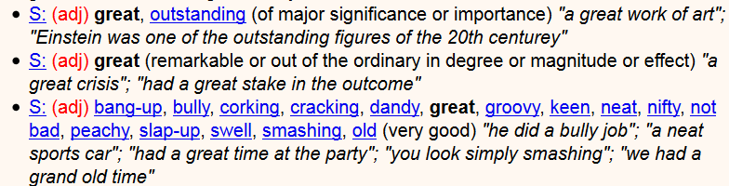
Opinion orientation
Start from lexicon
E.g. dictionary SentiWordNet
Assign +1/-1 to opinion words, change according to valence shifters (e.g. negation: not etc.)
But clauses (“the pictures are good, but the battery life ...“)
Dictionary-based: Use semantic relations (e.g. synonyms, antonyms)
Corpus-based:
learn from labelled examples
Disadvantage: need these (expensive!)
Advantage: domain dependence
Notes:
Researchers have also used additional information (e.g.,
glosses) in WordNet and additional techniques (e.g., machine learning)
to generate better lists [1, 19, 20, 45]. Several opinion word lists have
been produced [17, 21, 31, 90, 104].
21 = SentiWordNet

Slide 27
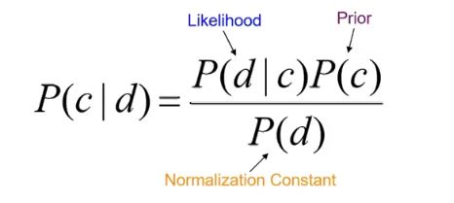
Example: Naive Bayes classification for sentiment analysis:
Apply Bayes rules for forming classification probabilities.
Example: For a document d and class c:
In this context,
The RHS term P(c|d) is read as the probability of class c given a document d. This term is also known as Posterior.
P(d|c) should be similar.

Slide 28
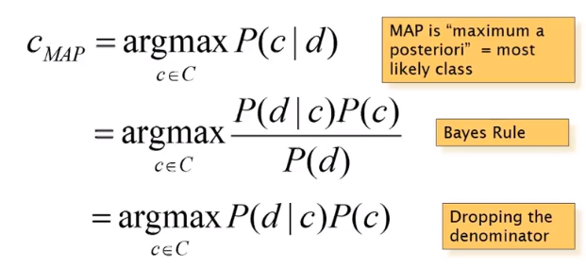
Contd.,
The term which is shown as Prior is your original belief i.e., original label of the document being positive or negative (in terms of sentiments).
The term Likelihood is the probability of a document d given a class c.
argmax denotes the index. Suppose the P(+|d) > P(-|d)
where + and - denote positive and negative sentiments respectively.
These terms P(+|d), P(-|d) return probabilities which are a numeric quantity.

Slide 29
Why is sentiment analysis so important?
Sentiment analysis solves a number of genuine business problems:
It helps to predict customer behavior for a particular product.
It can help to test the adaptability of a product.
Automates the task of customer preference reports.
It can easily automate the process of determining how well did a movie run by analyzing the sentiments behind the movie's reviews from a number of platforms.

Slide 30
Speech Analytics

Slide 31
What is speech recognition?
Speech recognition, also known as automatic speech recognition (ASR), computer speech recognition, or speech-to-text, is
a capability which enables a program to process human speech into a written format.
Key features of effective speech recognition
Many speech recognition applications and devices are available, but the more advanced solutions use AI and machine learning.
They integrate grammar, syntax, structure, and composition of audio and voice signals to understand and process human speech.
Example: Language weighting, Speaker labelling, Acoustics training, Profanity filtering, etc.,

Slide 32
Speech recognition algorithms
human speech development is very challenging.
It’s considered to be one of the most complex areas of computer science – involving linguistics, mathematics and statistics.
Speech recognizers are made up of a few components, such as
the speech input, feature extraction, feature vectors, a decoder, and a word output.
The decoder leverages acoustic models, a pronunciation dictionary, and language models to determine the appropriate output.

Slide 33
Contd.,
Hidden markov models (HMM):
Hidden Markov Models build on the Markov chain model, which stipulates that the probability of a given state hinges on the current state, not its prior states.
While a Markov chain model is useful for observable events, such as text inputs, hidden markov models allow us to incorporate hidden events, such as part-of-speech tags, into a probabilistic model. T
they are utilized as sequence models within speech recognition,
assigning labels to each unit—i.e. words, syllables, sentences, etc.—in the sequence.
These labels create a mapping with the provided input, allowing it to determine the most appropriate label sequence.
Natural language processing (NLP):
While NLP isn’t necessarily a specific algorithm used in speech recognition, it is the area of artificial intelligence which focuses on the interaction between humans and machines through language through speech and text.
Many mobile devices incorporate speech recognition into their systems to conduct voice search—e.g. Siri—or provide more accessibility around texting.

Slide 34
Contd.,
Neural networks:
Primarily leveraged for deep learning algorithms, neural networks process training data by mimicking the interconnectivity of the human brain through layers of nodes.
Each node is made up of inputs, weights, a bias (or threshold) and an output.
If that output value exceeds a given threshold, it “fires” or activates the node, passing data to the next layer in the network.
Neural networks learn this mapping function through supervised learning,
adjusting based on the loss function through the process of gradient descent.
While neural networks tend to be more accurate and can accept more data, this comes at a performance efficiency cost as they tend to be slower to train compared to traditional language models.

Slide 35
Contd.,
N-grams:
This is the simplest type of language model (LM), which assigns probabilities to sentences or phrases. An N-gram is sequence of N-words.
For example, “order the pizza” is a trigram or 3-gram and
“please order the pizza” is a 4-gram.
Grammar and the probability of certain word sequences are used to improve recognition and accuracy.
Speaker Diarization (SD):
Speaker diarization algorithms identify and segment speech by speaker identity.
This helps programs better distinguish individuals in a conversation and is frequently applied at call centers distinguishing customers and sales agents.

Slide 36
Applications
Automotive: Speech recognizers improves driver safety by enabling voice-activated navigation systems and search capabilities in car radios.
Technology: Virtual agents are increasingly becoming integrated within our daily lives, particularly on our mobile devices. We use voice commands to access them through our smartphones,
such as through Google Assistant or
Apple’s Siri, for tasks, such as voice search, or
through our speakers, via Amazon’s Alexa or Microsoft’s Cortana, to play music.
They’ll only continue to integrate into the everyday products that we use, fueling the “Internet of Things” movement.
Healthcare: Doctors and nurses leverage dictation applications to capture and log patient diagnoses and treatment notes.

Slide 37
Application - Contd.,
Sales: Speech recognition technology has a couple of applications in sales.
It can help a call center transcribe thousands of phone calls between customers and agents to identify common call patterns and issues.
AI chatbots can also talk to people via a webpage, answering common queries and solving basic requests without needing to wait for a contact center agent to be available.
It both instances speech recognition systems help reduce time to resolution for consumer issues.
Security:
As technology integrates into our daily lives, security protocols are an increasing priority.
Voice-based authentication adds a viable level of security.

Slide 38
Example
Speech Recognition and IBM
IBM has pioneered the development of Speech Recognition tools and services that enable organizations to automate their complex business processes while gaining essential business insights.
IBM Watson Speech to Text is a cloud-native solution that uses deep-learning AI algorithms to apply knowledge about grammar, language structure, and audio/voice signal composition to create customizable speech recognition for optimal text transcription.
IBM Watson Text to Speech generates human-like audio from written text, increasing customer engagement and satisfaction by improving accessibility across languages and interaction modalities.

Slide 39
Basic Concepts of Neural Networks

Slide 40
Basics of Neural Network
What is a Neural Network
Neural Network Classifier
Data Normalization
Neuron and bias of a neuron
Single Layer Feed Forward
Limitation
Multi Layer Feed Forward
Back propagation

Slide 41
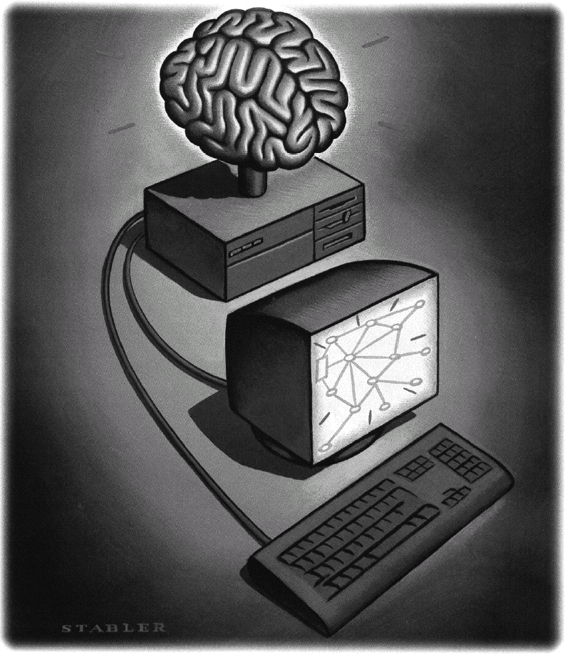
Neural Networks
What is a Neural Network?
Biologically motivated approach to machine learning
Similarity with biological network
Fundamental processing elements of a neural network is a neuron
1.Receives inputs from other source
2.Combines them in someway
3.Performs a generally nonlinear operation on the result
4.Outputs the final result

Slide 42
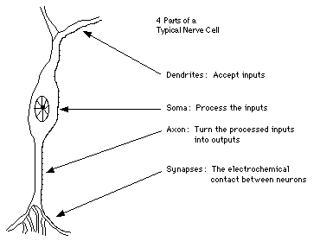
Similarity with Biological Network
Fundamental processing element of a neural network is a neuron
A human brain has 100 billion neurons
An ant brain has 250,000 neurons

Slide 43
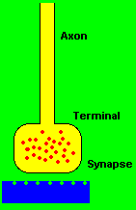
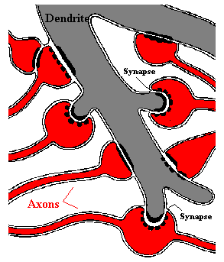
Synapses, the basis of learning and memory

Slide 44
Neural Network
Neural Network is a set of connected
INPUT/OUTPUT UNITS, where each connection has a WEIGHT associated with it.
Neural Network learning is also called CONNECTIONIST learning due to the connections between units.
It is a case of SUPERVISED, INDUCTIVE or CLASSIFICATION learning.

Slide 45
Neural Network
Neural Network learns by adjusting the weights so as to be able to correctly classify the training data and hence, after testing phase, to classify unknown data.
Neural Network needs long time for training.
Neural Network has a high tolerance to noisy and incomplete data

Slide 46
Neural Network Classifier
Input: Classification data
It contains classification attribute
Data is divided, as in any classification problem.
[Training data and Testing data]
All data must be normalized.
(i.e. all values of attributes in the database are changed to contain values in the internal [0,1] or[-1,1])
Neural Network can work with data in the range of (0,1) or (-1,1)
Two basic normalization techniques
[1] Max-Min normalization
[2] Decimal Scaling normalization

Slide 47
Data Normalization
[1] Max- Min normalization formula is as follows:
[minA, maxA , the minimun and maximum values of the attribute A
max-min normalization maps a value v of A to v’ in the range {new_minA, new_maxA} ]

Slide 48
Example of Max-Min Normalization
Max- Min normalization formula
Example: We want to normalize data to range of the interval [0,1].
We put: new_max A= 1, new_minA =0.
Say, max A was 100 and min A was 20 ( That means maximum and minimum values for the attribute ).
Now, if v = 40 ( If for this particular pattern , attribute value is 40 ), v’ will be calculated as , v’ = (40-20) x (1-0) / (100-20) + 0
=> v’ = 20 x 1/80
=> v’ = 0.4

Slide 49
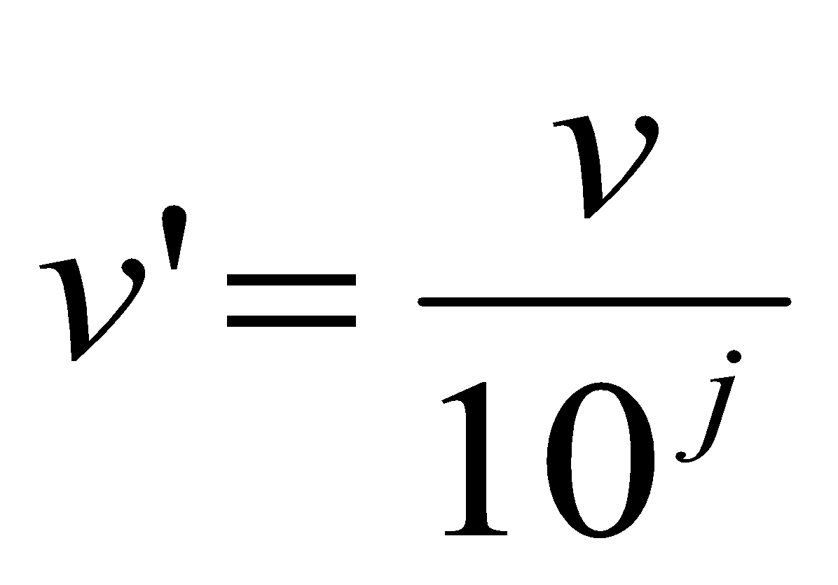
Decimal Scaling Normalization
[2]Decimal Scaling Normalization
Normalization by decimal scaling normalizes by moving the decimal point of values of attribute A.
Here j is the smallest integer such that max|v’|<1.
Example :
A – values range from -986 to 917. Max |v| = 986.
v = -986 normalize to v’ = -986/1000 = -0.986

Slide 50
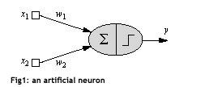
One Neuron as a Network
Here x1 and x2 are normalized attribute value of data.
y is the output of the neuron , i.e the class label.
x1 and x2 values multiplied by weight values w1 and w2 are input to the neuron x.
Value of x1 is multiplied by a weight w1 and values of x2 is multiplied by a weight w2.
Given that
w1 = 0.5 and w2 = 0.5
Say value of x1 is 0.3 and value of x2 is 0.8,
So, weighted sum is :
sum= w1 x x1 + w2 x x2 = 0.5 x 0.3 + 0.5 x 0.8 = 0.55

Slide 51
One Neuron as a Network
The neuron receives the weighted sum as input and calculates the output as a function of input as follows :
y = f(x) , where f(x) is defined as
f(x) = 0 { when x< 0.5 }
f(x) = 1 { when x >= 0.5 }
For our example, x ( weighted sum ) is 0.55, so y = 1 ,
That means corresponding input attribute values are classified in class 1.
If for another input values , x = 0.45 , then f(x) = 0,
so we could conclude that input values are classified to class 0.

Slide 52
Bias of a Neuron
We need the bias value to be added to the weighted sum ∑wixi so that we can transform it from the origin.
v = ∑wixi + b, here b is the bias
x1-x2= -1
x2
x1-x2=0
x1-x2= 1
x1

Slide 53

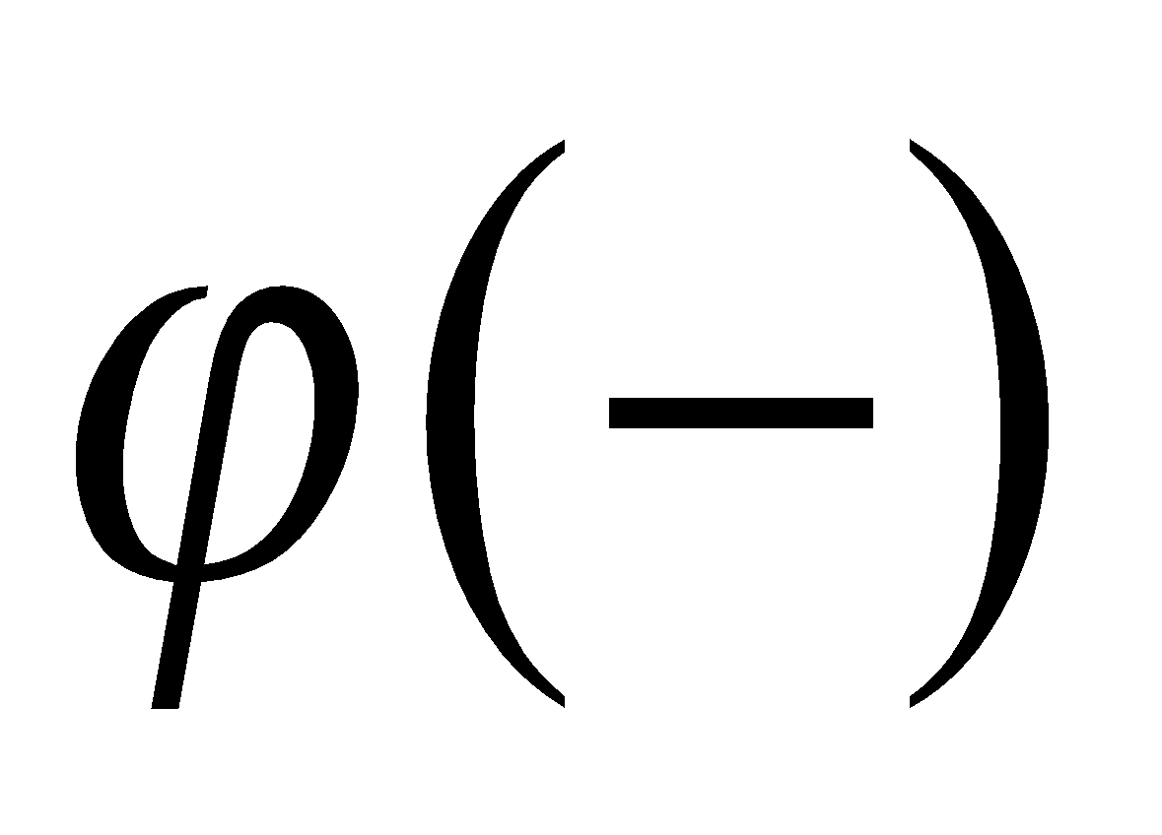

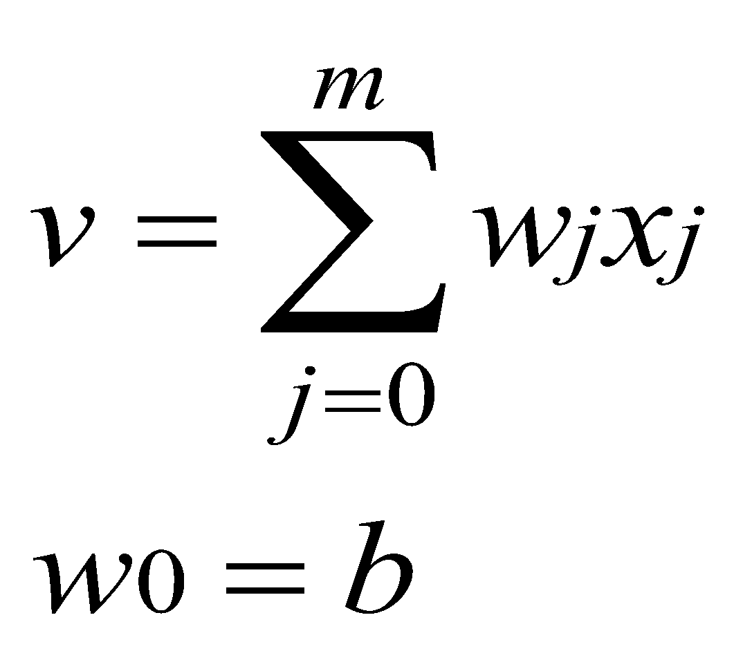
Bias as extra input
x₀ = +1
w₀
x₁
W1
Activation
function
v
Input
Attribute
values
Output
class
y
x₂
w₂
Summing function
x_{m}
w_{m}
weights

Slide 54
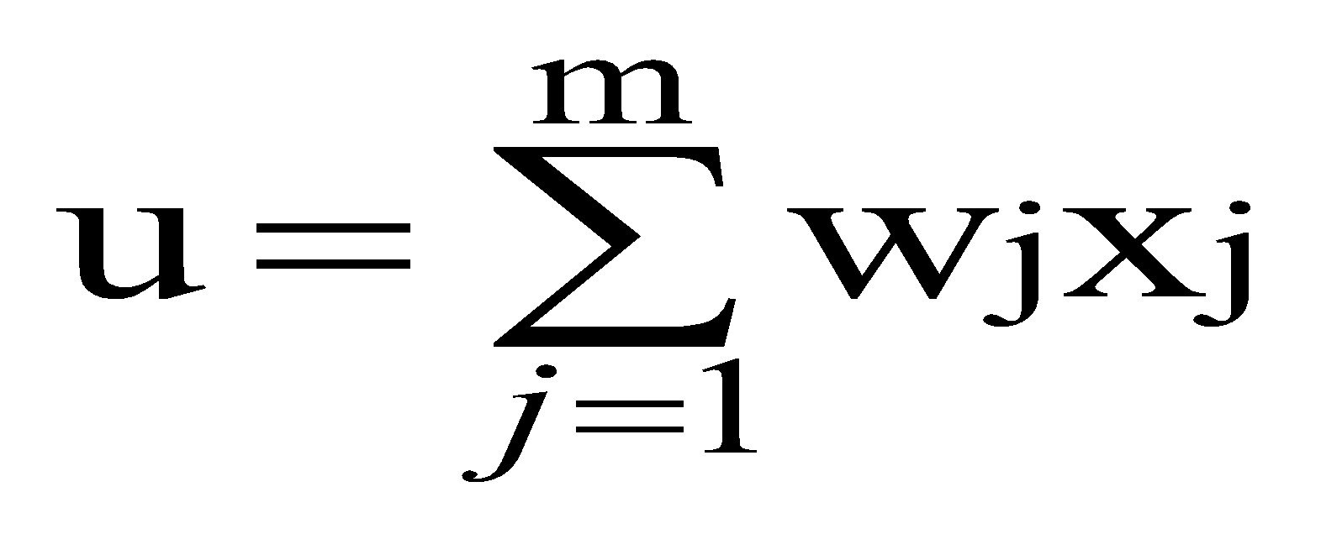
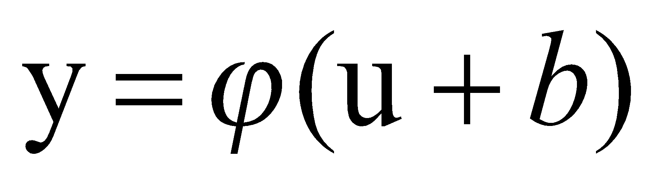
Neuron with Activation
The neuron is the basic information processing unit of a NN. It consists of:
1 A set of links, describing the neuron inputs, with weights W₁, W₂, …, W_{m}
2. An adder function (linear combiner) for computing the weighted sum of the inputs (real numbers):
3 Activation function : for limiting the amplitude of the neuron output.

Slide 55
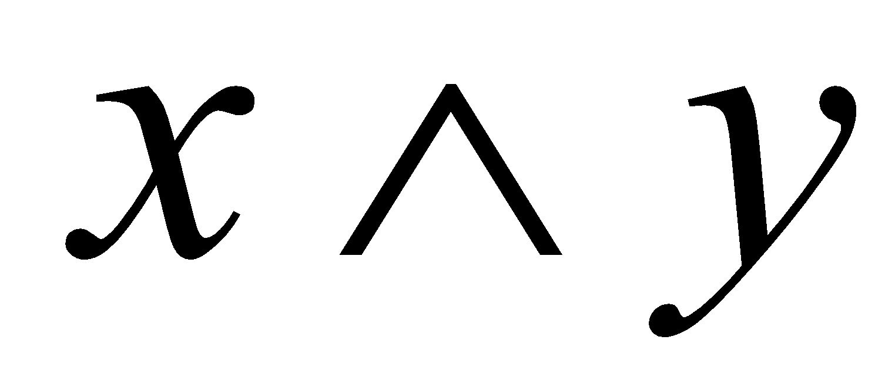
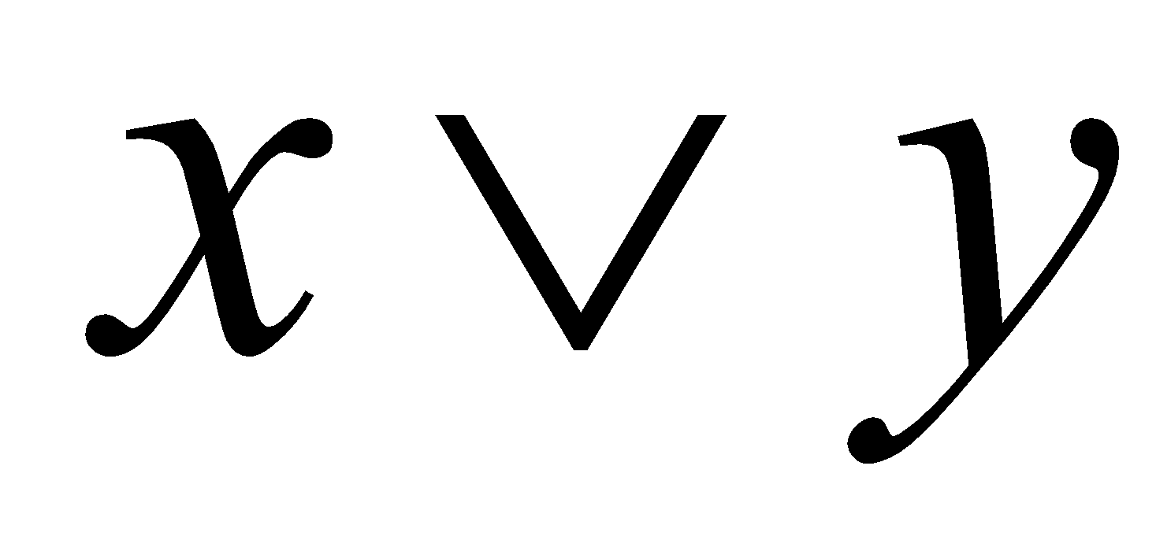
Why We Need Multi Layer ?
Linear Separable:
Linear inseparable:
Solution?

Slide 56
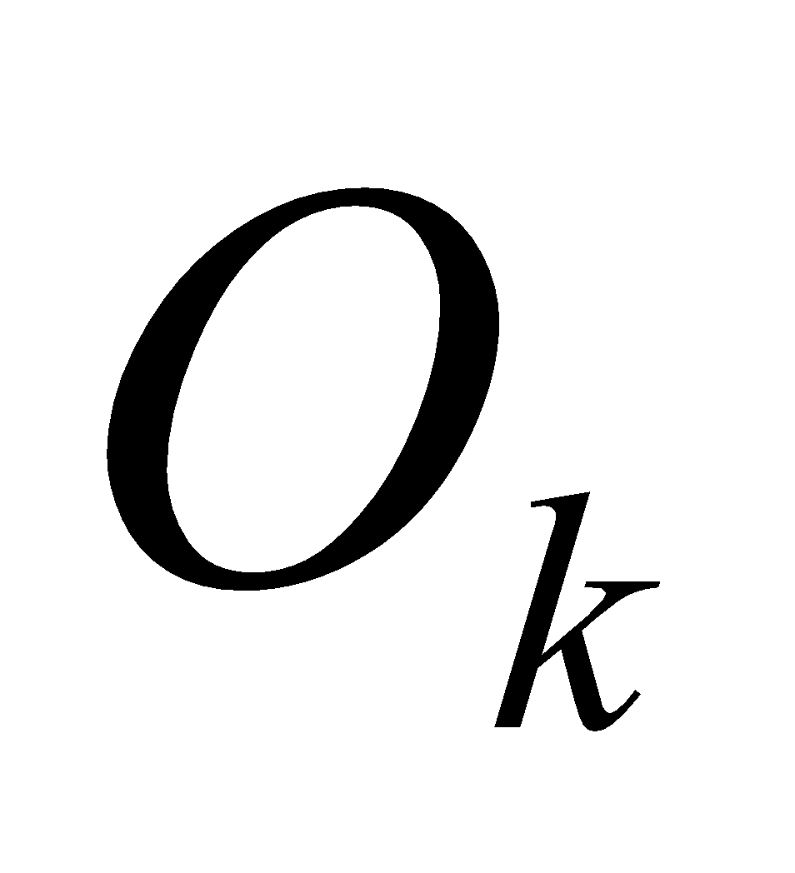


A Multilayer Feed-Forward Neural Network
Output Class
Output nodes
Hidden nodes
w_{ij}
- weights
Input nodes
Network is fully connected
Input Record : x_{i}

Slide 57
Neural Network Learning
The inputs are fed simultaneously into the input layer.
The weighted outputs of these units are fed into hidden layer.
The weighted outputs of the last hidden layer are inputs to units making up the output layer.

Slide 58
A Multilayer Feed Forward Network
The units in the hidden layers and output layer are sometimes referred to as neurodes, due to their symbolic biological basis, or as output units.
A network containing two hidden layers is called a three-layer neural network, and so on.
The network is feed-forward in that none of the weights cycles back to an input unit or to an output unit of a previous layer.

Slide 59
A Multilayered Feed – Forward Network
INPUT: records without class attribute with normalized attributes values.
INPUT VECTOR: X = { x1, x2, …. xn}
where n is the number of (non class) attributes.
INPUT LAYER – there are as many nodes as non-class attributes i.e. as the length of the input vector.
HIDDEN LAYER – the number of nodes in the hidden layer and the number of hidden layers depends on implementation.

Slide 60

A Multilayered Feed–Forward Network
OUTPUT LAYER – corresponds to the class attribute.
There are as many nodes as classes (values of the class attribute).
k= 1, 2,.. #classes
Network is fully connected, i.e. each unit provides input
to each unit in the next forward layer.

Slide 61
Classification by Back propagation
Back Propagation learns by iteratively processing a set of training data (samples).
For each sample, weights are modified to minimize the error between network’s classification and actual classification.

Slide 62
Steps in Back propagation Algorithm
STEP ONE: initialize the weights and biases.
The weights in the network are initialized to random numbers from the interval [-1,1].
Each unit has a BIAS associated with it
The biases are similarly initialized to random numbers from the interval [-1,1].
STEP TWO: feed the training sample.

Slide 63
Steps in Back propagation Algorithm ( cont..)
STEP THREE: Propagate the inputs forward; we compute the net input and output of each unit in the hidden and output layers.
STEP FOUR: back propagate the error.
STEP FIVE: update weights and biases to reflect the propagated errors.
STEP SIX: terminating conditions.

Slide 64
Propagation through Hidden Layer ( One Node )
-
Bias Θj
x₀
w_{0j}
x₁
w_{1j}
∑
f
output y
x_{n}
w_{nj}
Input
vector x
weight
vector w
weighted
sum
Activation
function
The inputs to unit j are outputs from the previous layer. These are multiplied by their corresponding weights in order to form a weighted sum, which is added to the bias associated with unit j.
A nonlinear activation function f is applied to the net input.

Slide 65
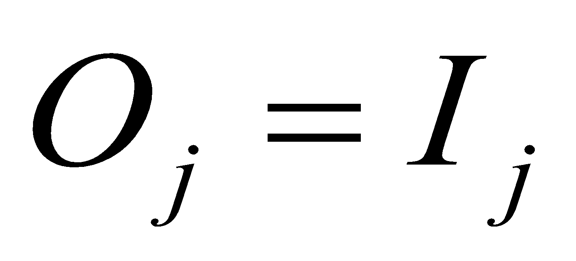
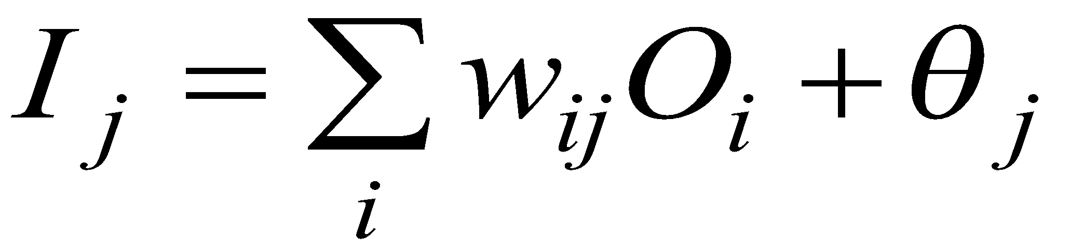
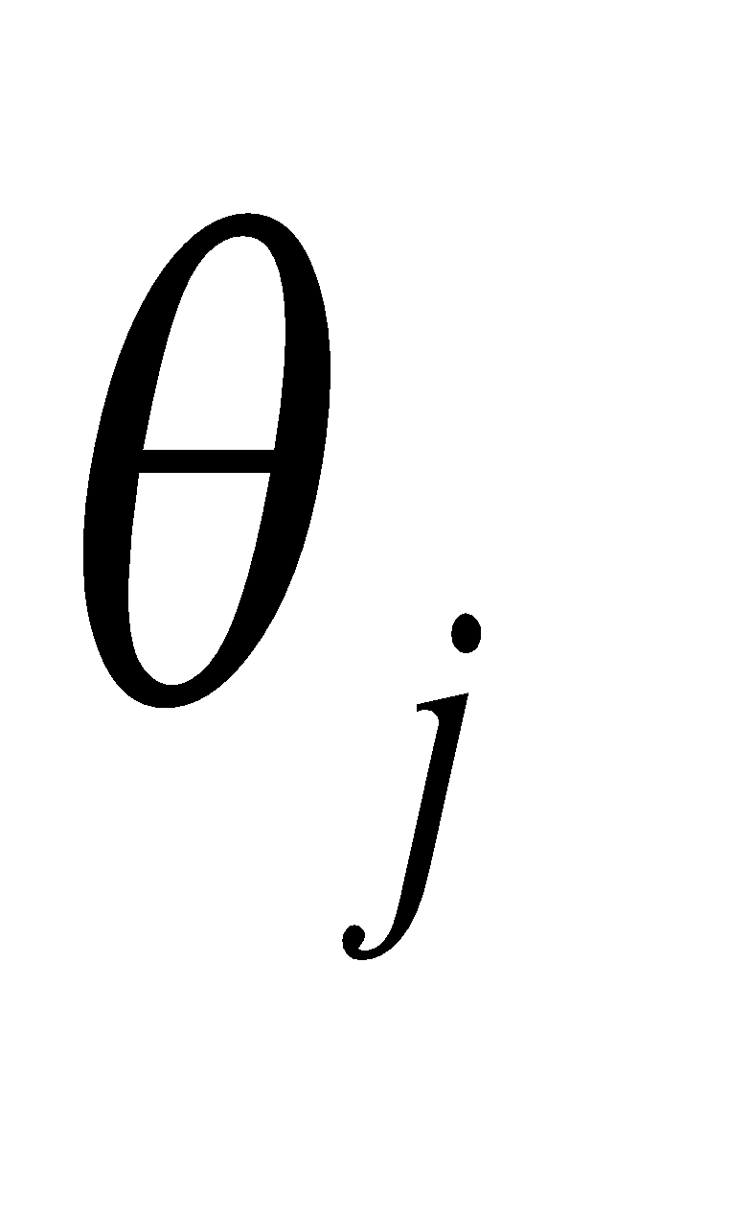
Propagate the inputs forward
For unit j in the input layer, its output is equal to its input, that is,
for input unit j.
The net input to each unit in the hidden and output layers is computed as follows.
Given a unit j in a hidden or output layer, the net input is
where wij is the weight of the connection from unit i in the previous layer to unit j; Oi is the output of unit I from the previous layer;
is the bias of the unit

Slide 66
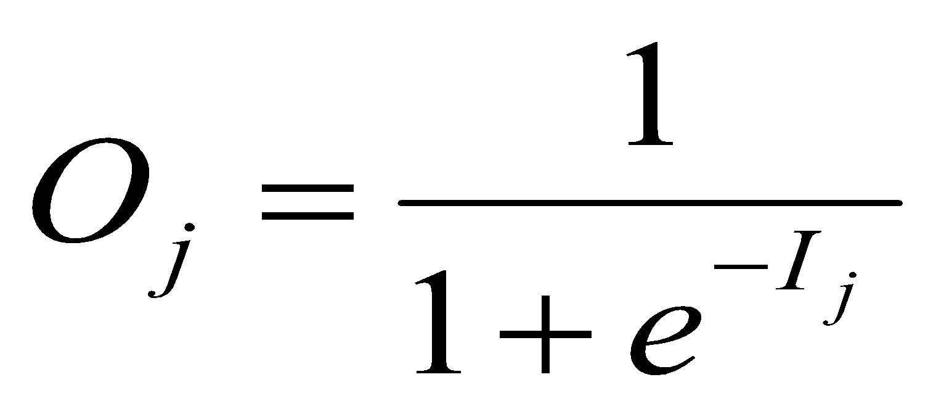
Propagate the inputs forward
Each unit in the hidden and output layers takes its net input and then applies an activation function. The function symbolizes the activation of the neuron represented by the unit. It is also called a logistic, sigmoid, or squashing function.
Given a net input Ij to unit j, then
Oj = f(Ij),
the output of unit j, is computed as

Slide 67
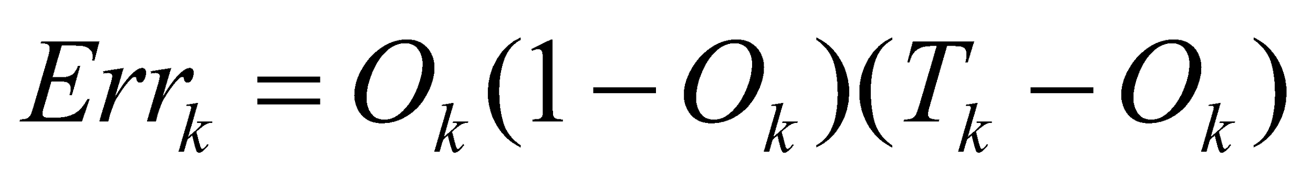
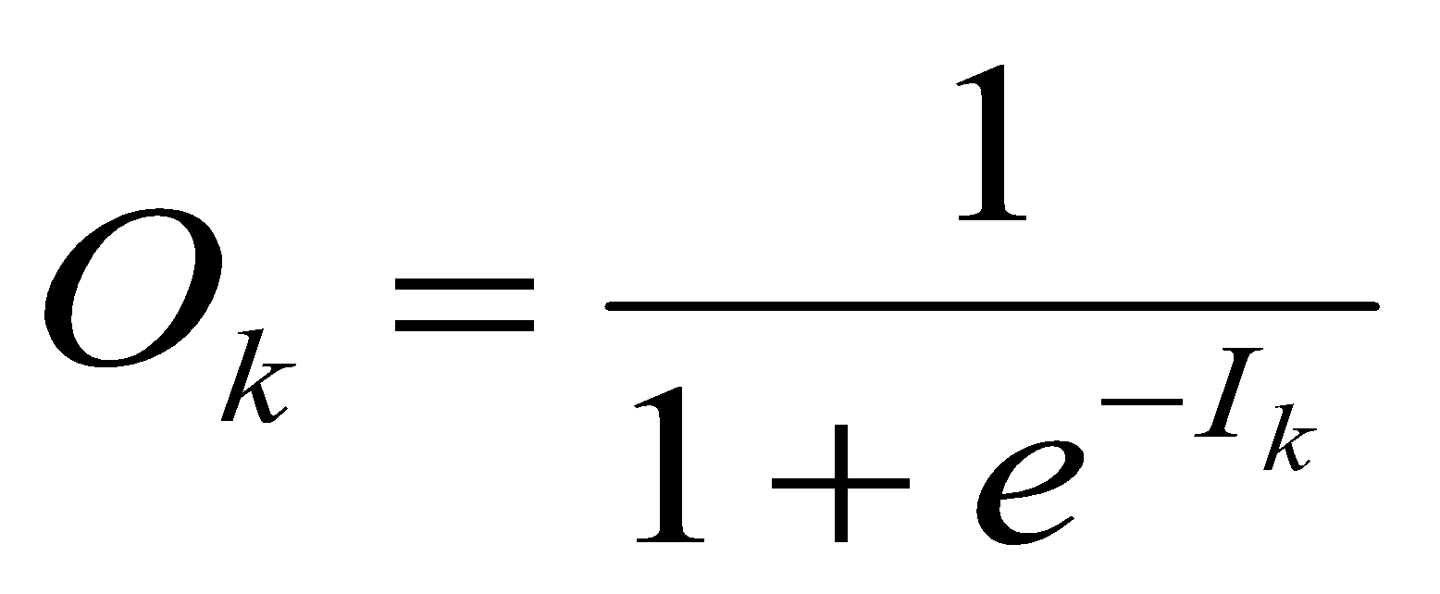
Back propagate the error
When reaching the Output layer, the error is computed and propagated backwards.
For a unit k in the output layer the error is computed by a formula:
Where O k – actual output of unit k ( computed by activation function.
Tk – True output based of known class label; classification of training sample
Ok(1-Ok) – is a Derivative ( rate of change ) of activation function.

Slide 68
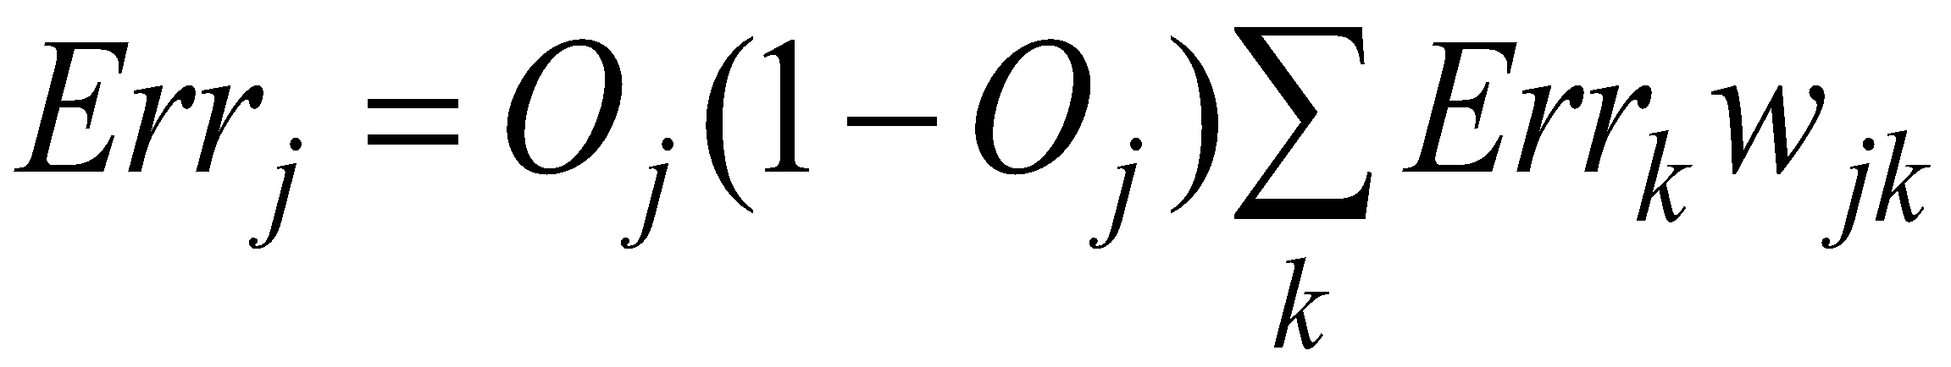
Back propagate the error
The error is propagated backwards by updating weights and biases to reflect the error of the network classification .
For a unit j in the hidden layer the error is computed by a formula:
where wjk is the weight of the connection from unit j to unit k in the next higher layer, and Errk is the error of unit k.

Slide 69
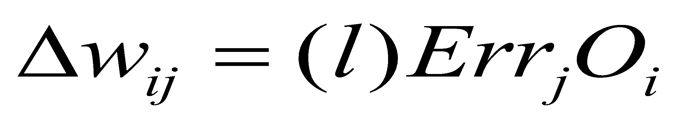

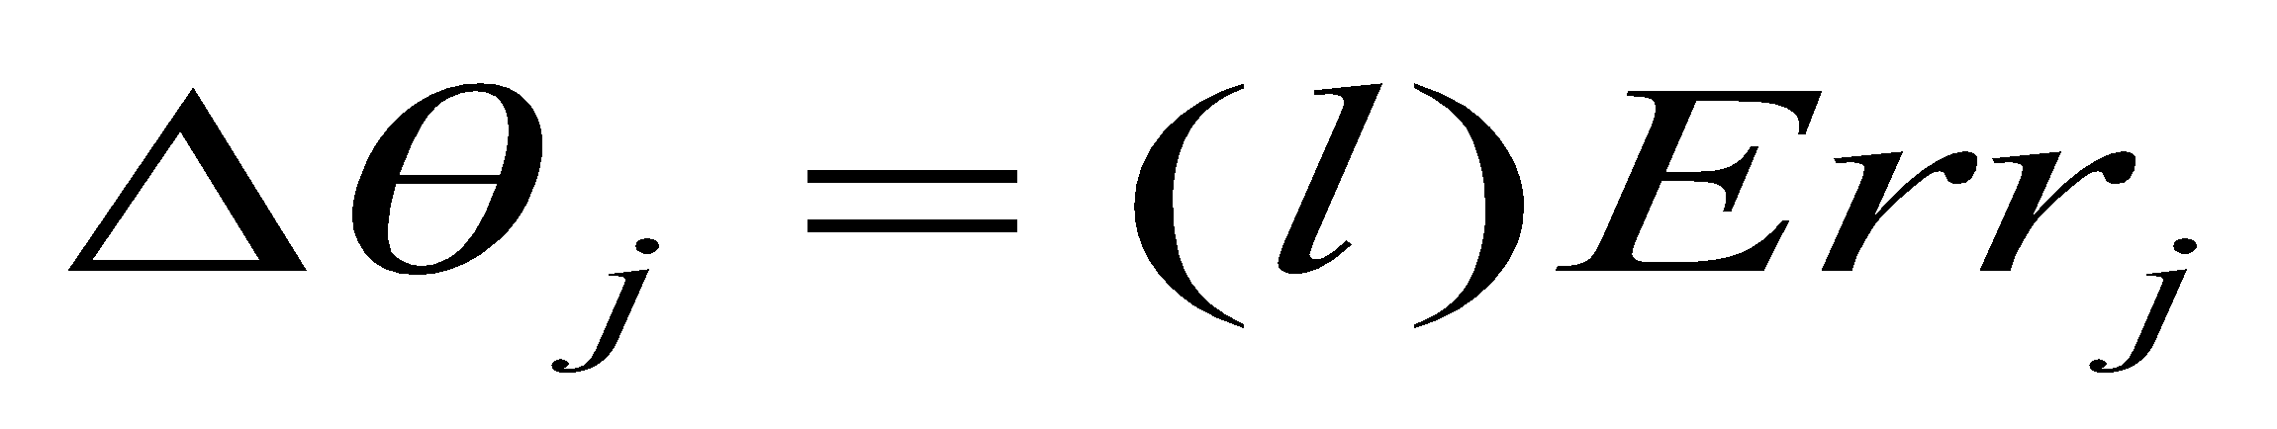
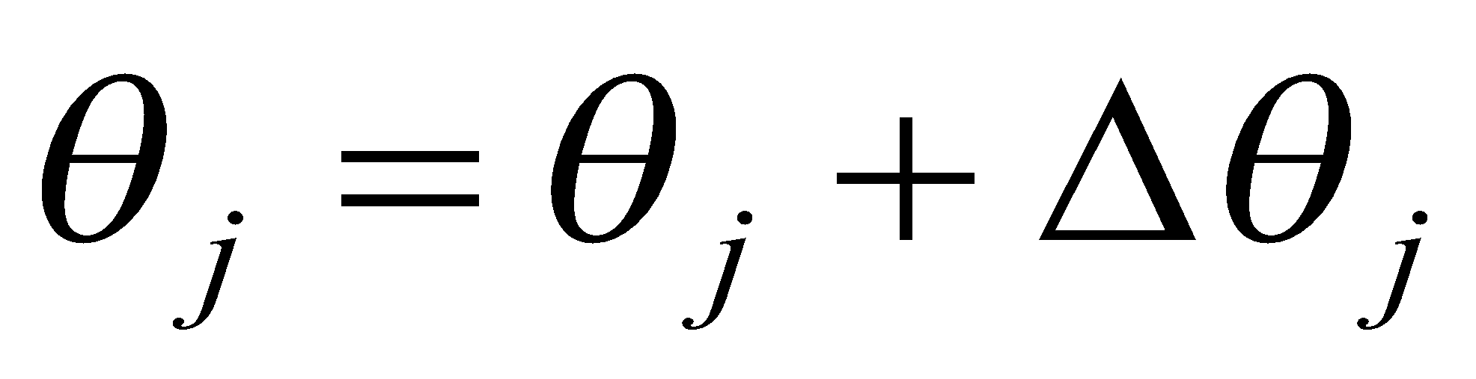
Update weights and biases
Weights are updated by the following equations, where l is a constant between 0.0 and 1.0 reflecting the learning rate, this learning rate is fixed for implementation.
Biases are updated by the following equations

Slide 70
Update weights and biases
We are updating weights and biases after the presentation of each sample.
This is called case updating.
Epoch --- One iteration through the training set is called an epoch.
Epoch updating ------------
Alternatively, the weight and bias increments could be accumulated in variables and the weights and biases updated after all of the samples of the training set have been presented.
Case updating is more accurate

Slide 71

Terminating Conditions
Training stops
All
in the previous epoch are below some threshold, or
The percentage of samples misclassified in the previous epoch is below some threshold, or
a pre specified number of epochs has expired.
In practice, several hundreds of thousands of epochs may be required before the weights will converge.

Slide 72
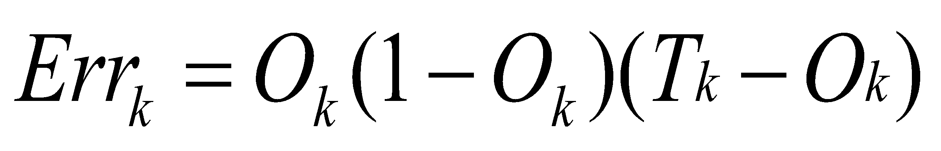
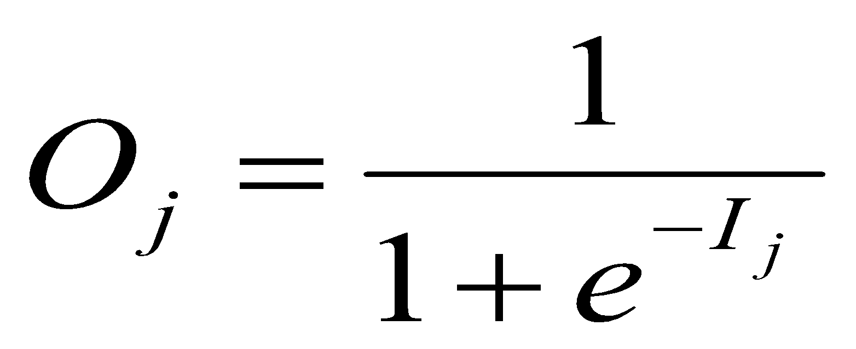
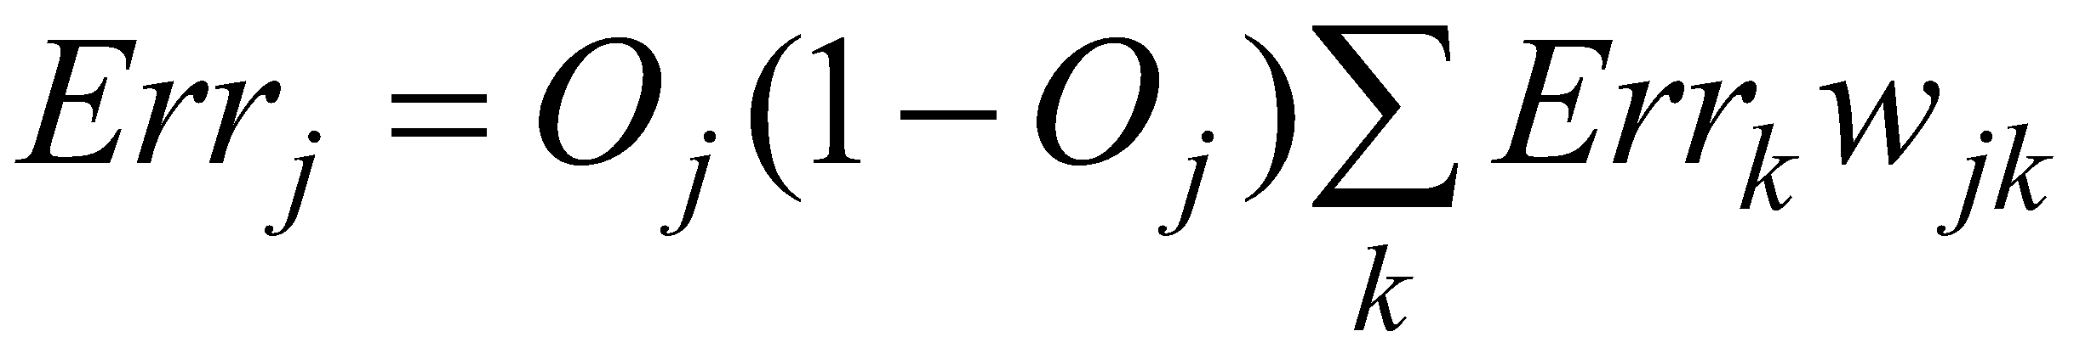
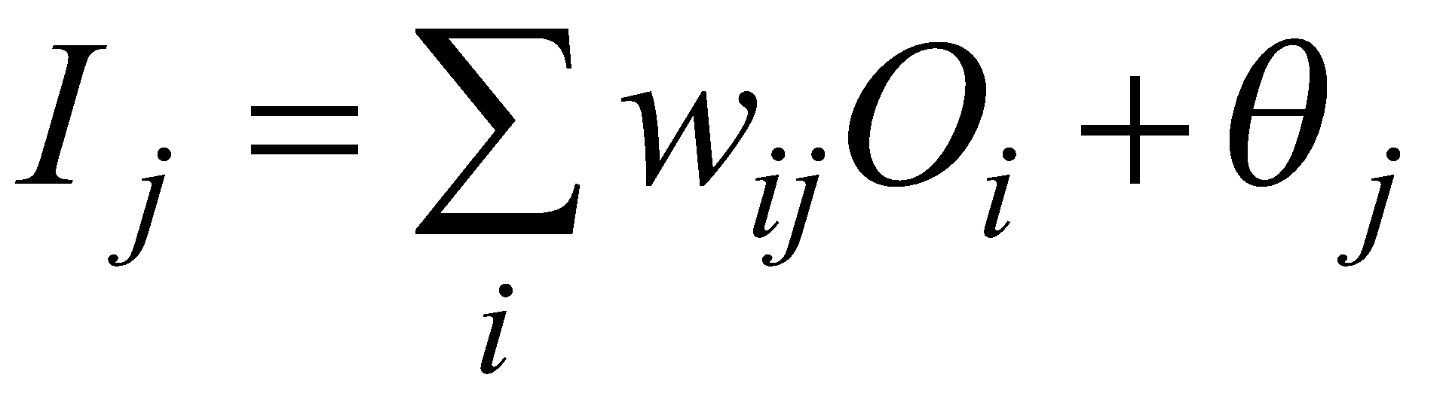
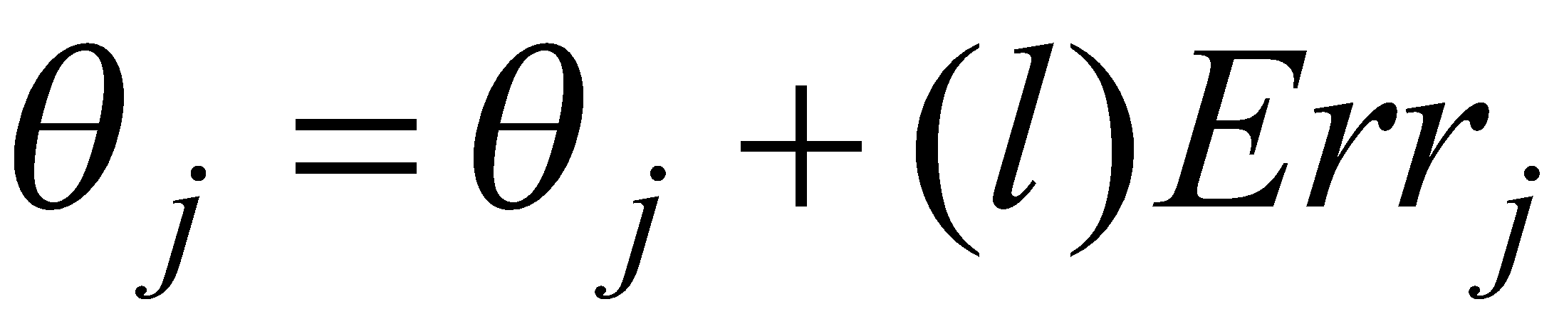

Backpropagation Formulas
Output vector
Output nodes
Hidden nodes
w_{ij}
Input nodes
Input vector: x_{i}

Slide 73
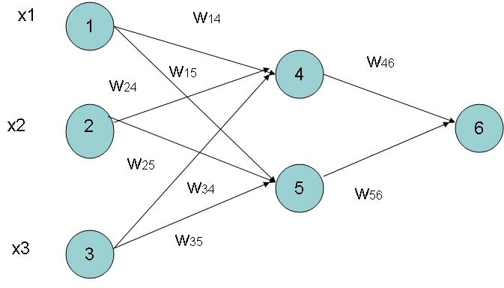
Example of Back propagation
Input = 3, Hidden Neuron = 2 Output =1
Initialize weights :
Random Numbers from -1.0 to 1.0
Initial Input and weight
x1 | x2 | x3 | w14 | w15 | w24 | w25 | w34 | w35 | w46 | w56
1 | 0 | 1 | 0.2 | -0.3 | 0.4 | 0.1 | -0.5 | 0.2 | -0.3 | -0.2

Slide 74
Example ( cont.. )
Bias added to Hidden
+ Output nodes
Initialize Bias
Random Values from
-1.0 to 1.0
Bias ( Random )
θ4 | θ5 | θ6
-0.4 | 0.2 | 0.1

Slide 75
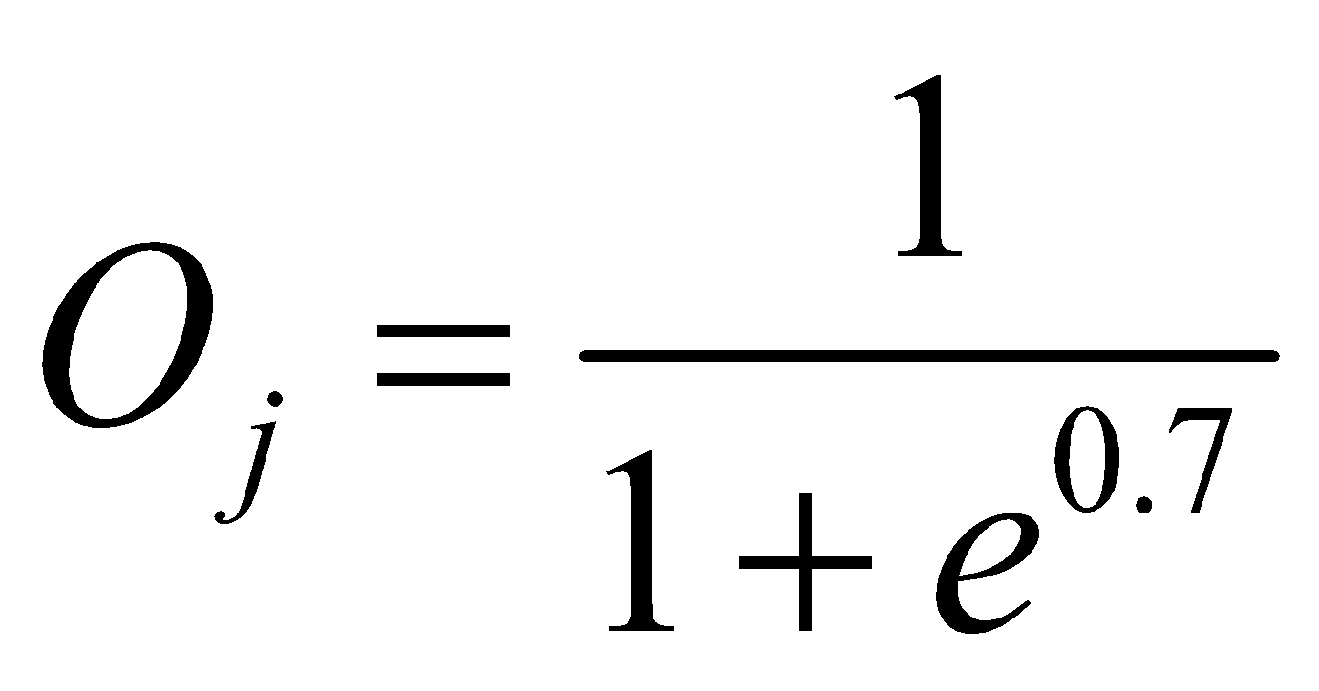
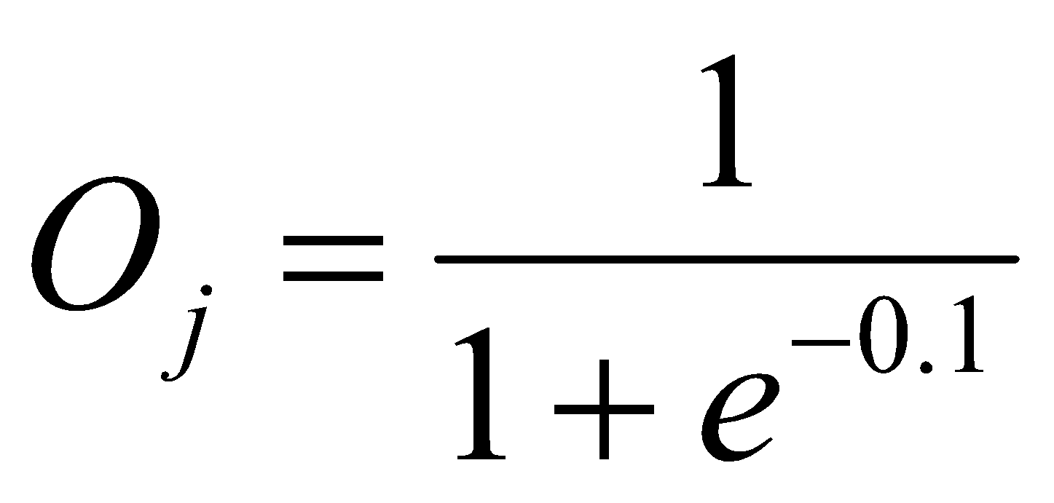
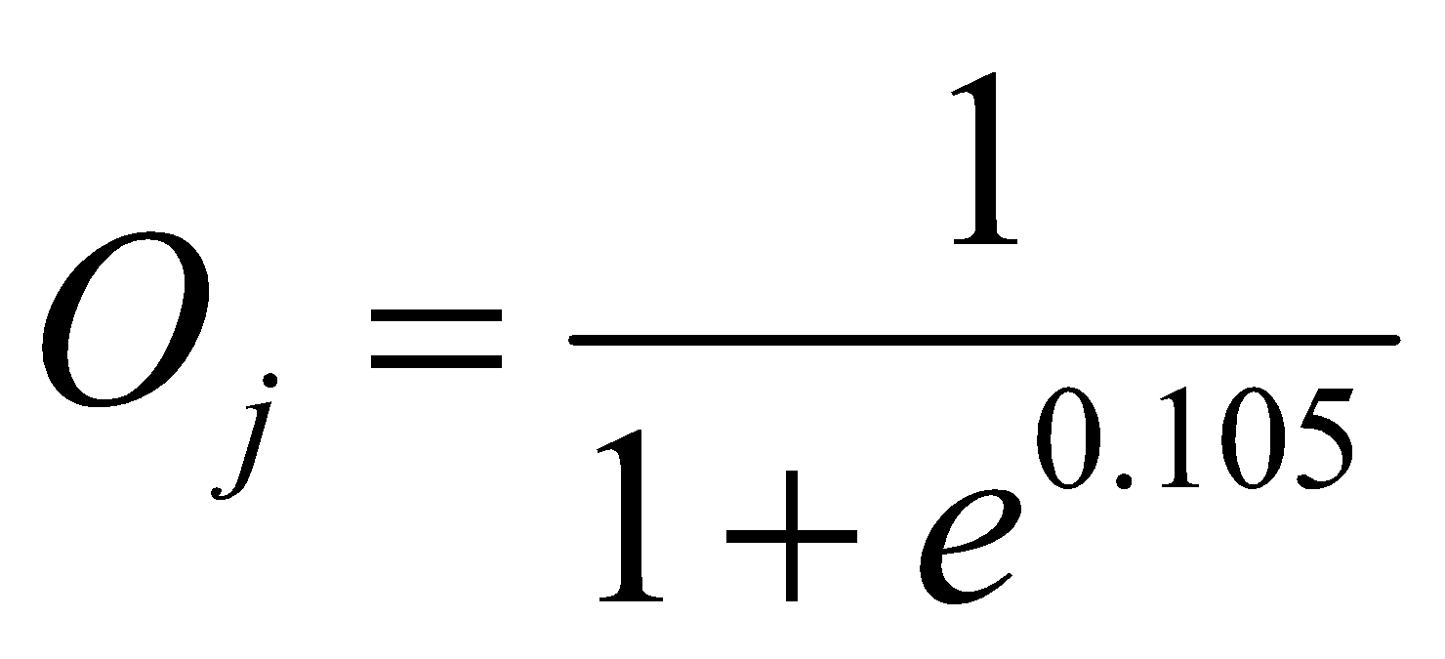
Net Input and Output Calculation
Unitj | Net Input Ij | Output Oj
4 | 0.2 + 0 + 0.5 -0.4 = -0.7
5 | -0.3 + 0 + 0.2 + 0.2 =0.1
6 | (-0.3)0.332-(0.2)(0.525)+0.1= -0.105
= 0.332
= 0.525
= 0.475

Slide 76
Calculation of Error at Each Node
Unit j | Error j
6 | 0.475(1-0.475)(1-0.475) =0.1311 We assume T 6 = 1
5 | 0.525 x (1- 0.525)x 0.1311x (-0.2) = 0.0065
4 | 0.332 x (1-0.332) x 0.1311 x (-0.3) = -0.0087

Slide 77
Calculation of weights and Bias Updating
Learning Rate l =0.9
Weight | New Values
w46 | -0.3 + 0.9(0.1311)(0.332) = -0.261
w56 | -0.2 + (0.9)(0.1311)(0.525) = -0.138
w14 | 0.2 + 0.9(-0.0087)(1) = 0.192
w15 | -0.3 + (0.9)(-0.0065)(1) = -0.306
……..similarly | ………similarly
θ6 | 0.1 +(0.9)(0.1311)=0.218
……..similarly | ………similarly

Slide 78
Network Pruning and Rule Extraction
Network pruning
Fully connected network will be hard to articulate
N input nodes, h hidden nodes and m output nodes lead to h(m+N) weights
Pruning: Remove some of the links without affecting classification accuracy of the network

Slide 79
Advanced Features of Neural Network
Training with Subsets
Modular Neural Network
Evolution of Neural Network

Slide 80
Variants of Neural Networks Learning
Supervised learning/Classification
Control
Function approximation
Associative memory
Unsupervised learning or Clustering

Slide 81
Training with Subsets
Select subsets of data
Build new classifier on subset
Aggregate with previous classifiers
Compare error after adding classifier
Repeat as long as error decreases
Notes:
Error after adding each classifier compared against the previous error
– process repeats as long as the error decreases
He suggested two mechanisms for pasting votes
Pasting Rvotes (Random Votes)
Simple approach -- each example has equal probability of getting selected
A method for creating an ensemble classifier in a small number of passes through data
Pasting Ivotes (Important Votes)
Select the examples based on whether the out-of-bag classifier classifies them correctly
An out0of-bag classifier is constructed by first forming bootstrap training sets and
collecting the bagging predictor votes from the examples omitted by the bootstrap sample
Pasting Ivotes proves to be a more accurate method
Similarity – entire database is never in main memory at a time
Difference – we are able to use all of the data in building a single classifier
A single classifier – possibly a more accurate single classifier and faster too..
We also need only random access to the data on disk

Slide 82
Training with subsets
Subset 1
NN 1
Subset 2
NN 2
The
Whole
Dataset
Split the dataset
into subsets
that can fit
into memory
Subset 3
NN 3
.
.
.
Subset n
NN n
A Single
Neural Network
Model
Notes:
Break the data into subsets, that can fit in memory
Train one neural network on a series of the subsets
The result is a single neural network model
In this way, we attempt to overcome the difficulty addressed by catlett,
making use of all the available data, without leaving anything

Slide 83
Modular Neural Network
Modular Neural Network
Made up of a combination of several neural networks.
The idea is to reduce the load for each neural network as opposed to trying to solve the problem on a single neural network.
Notes:
Error after adding each classifier compared against the previous error
– process repeats as long as the error decreases
He suggested two mechanisms for pasting votes
Pasting Rvotes (Random Votes)
Simple approach -- each example has equal probability of getting selected
A method for creating an ensemble classifier in a small number of passes through data
Pasting Ivotes (Important Votes)
Select the examples based on whether the out-of-bag classifier classifies them correctly
An out0of-bag classifier is constructed by first forming bootstrap training sets and
collecting the bagging predictor votes from the examples omitted by the bootstrap sample
Pasting Ivotes proves to be a more accurate method
Similarity – entire database is never in main memory at a time
Difference – we are able to use all of the data in building a single classifier
A single classifier – possibly a more accurate single classifier and faster too..
We also need only random access to the data on disk

Slide 84
Evolving Network Architectures
Small networks without a hidden layer can’t solve problems such as XOR, that are not linearly separable.
Large networks can easily overfit a problem to match the training data, limiting their ability to generalize a problem set.

Slide 85
Constructive vs Destructive Algorithm
Constructive algorithms take a minimal network and build up new layers nodes and connections during training.
Destructive algorithms take a maximal network and prunes unnecessary layers nodes and connections during training.

Slide 86
Training Process of the MLP
The training will be continued until the RMS is minimized.
ERROR
Local Minimum
Local Minimum
Global Minimum
W (N dimensional)

Slide 87
Faster Convergence
Back prop requires many epochs to converge
Some ideas to overcome this
Stochastic learning
Update weights after each training example
Momentum
Add fraction of previous update to current update
Faster convergence
Notes:
An epoch is one presentation of all the training examples in the dataset
Stochastic learning
Updates weights after each example, instead of updating them after one epoch
Momentum term
This optimization is due to the fact that it speeds up the learning when the weights
are moving in a single direction continuously by increasing the size of steps
The closer this value is to one, the more each weight change will not only include
the current error, but also the weight change from previous examples
(which often leads to faster convergence)

Slide 88
Applications-I
Handwritten Digit Recognition
Face recognition
Time series prediction
Process identification
Process control
Optical character recognition

Slide 89

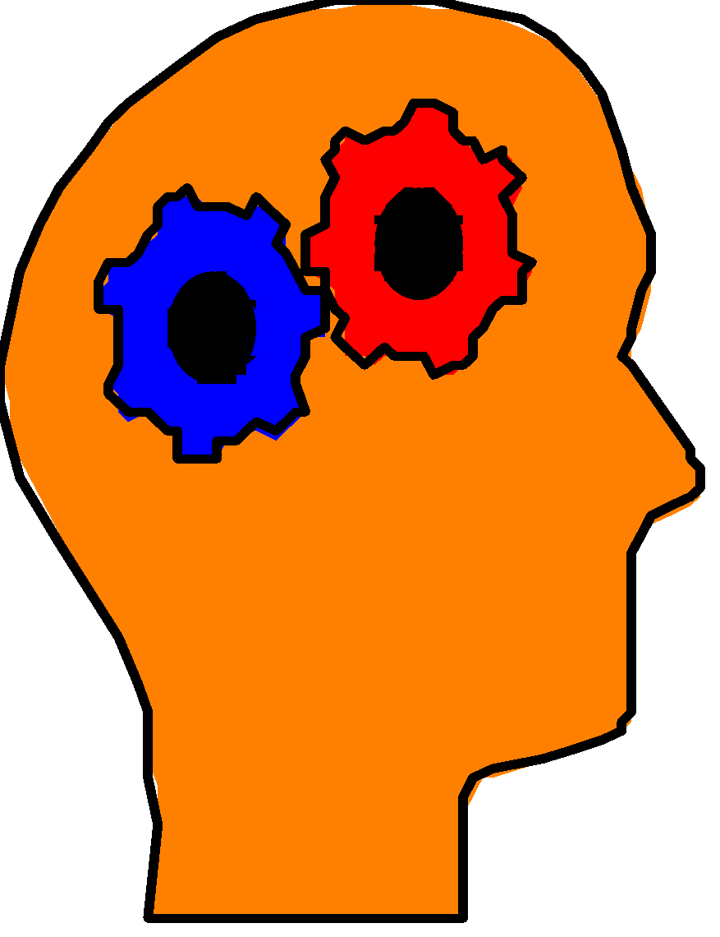
Application-II
Forecasting/Market Prediction: finance and banking
Manufacturing: quality control, fault diagnosis
Medicine: analysis of electrocardiogram data, RNA & DNA sequencing, drug development without animal testing
Control: process, robotics

